Slide 1
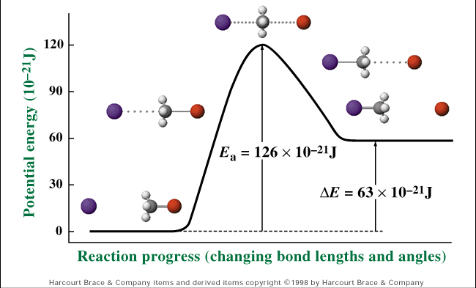
V. Reaction Rate
(p. 532 - 541)
Chemical Reactions

Slide 2
Standard 7. Solutions, Rates of Reaction, and Equilibrium
7.5 Identify the factors that affect the rate of a chemical reaction (temperature, mixing, concentration, particle size, surface area, and catalyst).

Slide 3
A. Collision Theory
Reaction rate depends on the collisions between reacting particles.
Successful collisions occur if the particles...
  collide with each other
  have the correct orientation
  have enough kinetic energy to break bonds

Slide 4
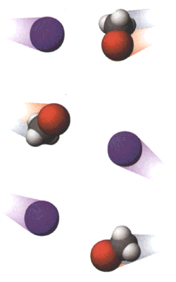


A. Collision Theory
Particle Orientation
Required Orientation
Unsuccessful Collisions
Successful Collision

Slide 5
A. Collision Theory
Activation Energy (E_{a})
  minimum energy required for a reaction to occur
Activation
Energy

Slide 6
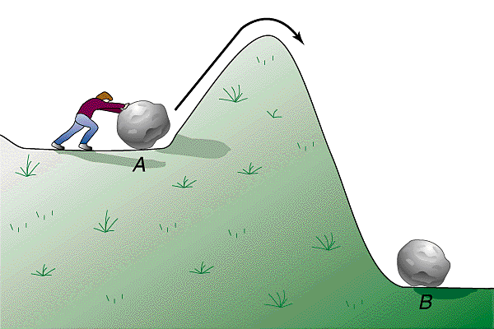
A. Collision Theory
Activation Energy
  depends on reactants
  low E_{a} = fast reaction rate
E_{a}

Slide 7
B. Factors Affecting Rxn. Rate
Surface Area
  high SA = fast reaction rate
  more opportunities for collisions
  Increase surface area by…
    using smaller particles (crushing)
    dissolving in water

Slide 8
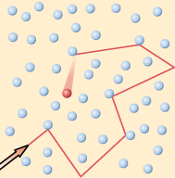
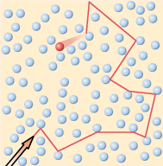
B. Factors Affecting Rxn Rate
Concentration
  high concentration = fast reaction rate
  more opportunities for collisions

Slide 9
B. Factors Affecting Rxn. Rate
Temperature
  high temp = fast reaction rate
  high KE
    fast-moving particles
    more likely to reach activation energy

Slide 10
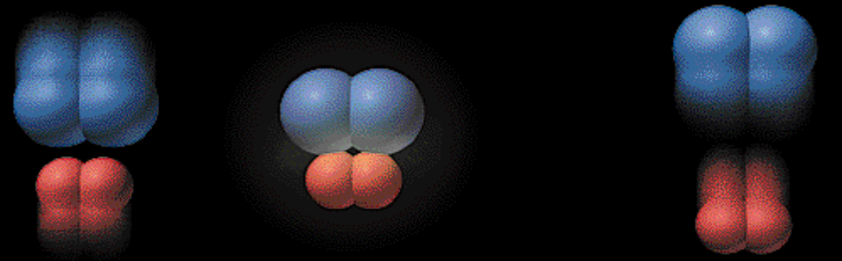
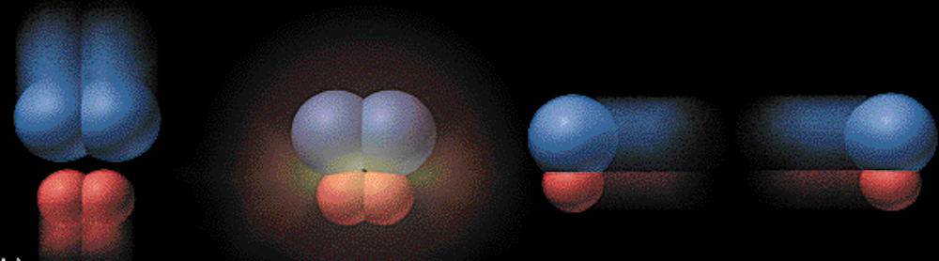
B. Factors Affecting Rxn. Rate
Temperature
Analogy: 2-car collision
5 mph “fender bender”
50 mph “high-speed crash”

Slide 11
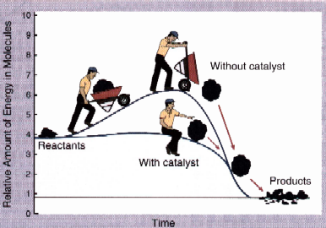
B. Factors Affecting Rxn. Rate
Catalyst
  substance that increases rxn. rate without being consumed in the rxn.
  lowers the activation energy

Slide 12
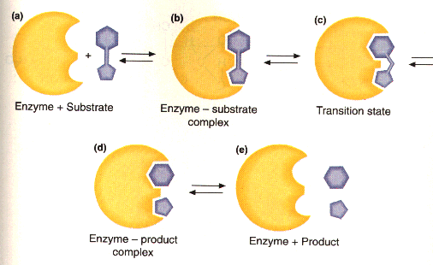
B. Factors Affecting Rxn Rate
Enzyme Catalysis

